Slide 1

Results from the ATLAS search for H→ττ
ATLAS UK Meeting
University of Edinburgh
8 January 2014
Katy Grimm* for ATLAS
The UK contingent of the Htautau team:
Eva Bouhova-Thacker*, Harald Fox*, Harvey Maddocks*
Sinead Farrington¹, , Michel Janus¹, Carl Jeske¹, James Longstaffe¹,
Elisabetta Pianori¹, and Martin Spangenberg¹
Jacob Howard²,, Mark Pickering²
*Lancaster University
¹University of Warwick
²Oxford University

Slide 2
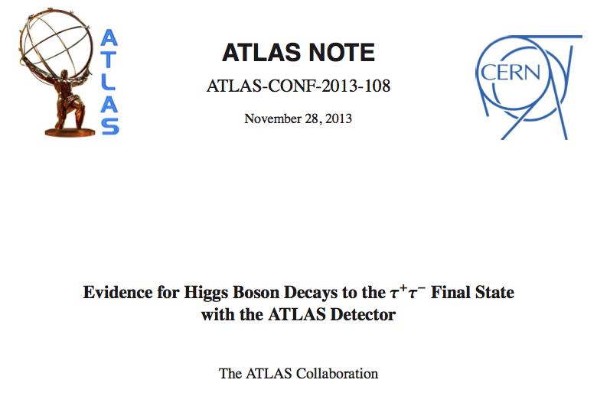
Introduction
On 26 November ATLAS presented the latest H→tautau search results with 20.3 fb⁻¹ of 8 TeV data
The deviation from background-only was at the level of 4.1 standard deviations. This was the first time a H→tautau or H→2Fermions result over 3 sigma had been seen.

Slide 3
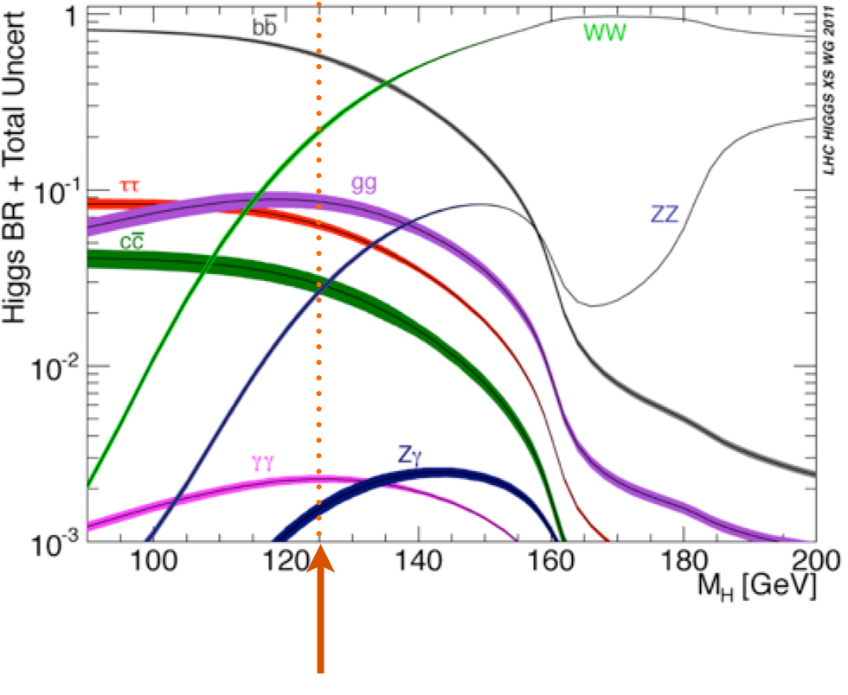
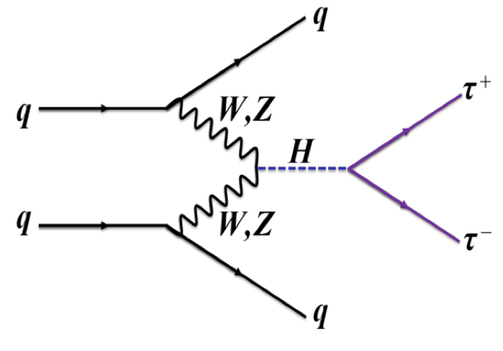
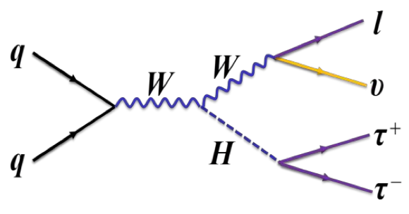
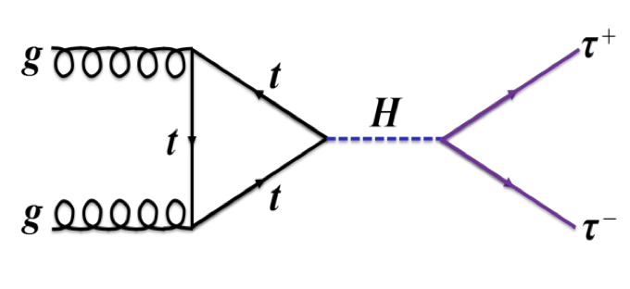
H Production and Decay Modes
Higgs Decays to Taus 6.4% of the time at m_{H} = 125 GeV
Most sensitive in the VBF channel
Additional large contribution from GGF and small contribution from associated production
VBF
ggF
WH/ZH
, j
, j
Z/
Notes:
Htautau is the most sensitive channel to the VBF production mode

Slide 4
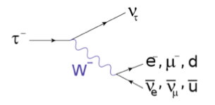
H→ττ at ATLAS
Since HCP 2012, the ATLAS Htautau search moved to a Multivariate (Boosted Decision Tree) analysis
Analysis framed to test for SM Higgs decaying to taus in the SM mass range
Analysis is performed for all final state of tau decays:
H→ττ →lepton lepton + 4ν, BR = 12.4%
H→ττ →lepton hadron + 3ν, BR = 45.6%
H→ττ →hadron hadron + 2ν, BR = 42%
Notes:
not measuring mass
three decay channels
pluses and minus of each channel– BR and # neutrinos and ease of measuring leptons vs taus.

Slide 5
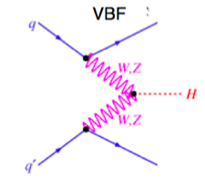
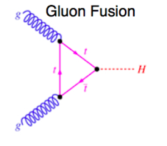
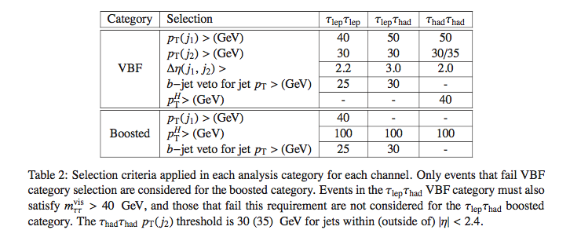
Signal Region Categories
Sub Categories with in each channel are created based on signal kinematics
Forward jet
signature
Largest production mode
Notes:
Say that this is on top of preselection which does basic tau cuts

Slide 6
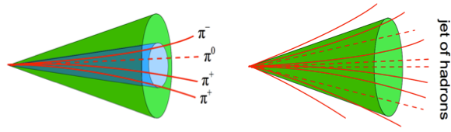
Taus at ATLAS
m_{τ} = 1.78 GeV; Decay length = 87μm – taus almost always decay within the beam pipe.
Decay Hadronically or Leptonically
Hadronic decays are highly collimated and have low track multiplicity– 1 or 3 charged pions
TauID (and lepton suppression) uses Multivariate Techniques that take advantages of shower-shape and track information
1 Prong (BR = 49.5%):
Corresponds mostly to:
τ± →π± ν_{τ}
or to:
τ± →ρ± (→πºπ±) ν_{τ}
3 Prong (BR = 15.2%):
Corresponds mostly to:
τ± →a₁± (→ρºπ± →3π±) ν_{τ}
Notes:
Taus are seeded by anit-kt jets (R=4)
This provides the initial axis, the clusters, the tracks for vertex association
Tracks within dR <0.4 of jet seed are associated to the tau
The core tracks are defined as those with dR<0.2. The core tracks are used to define the charge.

Slide 7
Taus at ATLAS
ATLAS uses a BDT to identify taus, based on tracking and shower-shape calorimeter training inputs
A separate BDT is trained purely for tau electron veto.
“medium tau”
“tight tau”
Notes:
A dedicated selection to reject fake tau candidates from
397 electrons and muons is applied. In particular the standard muon veto and the “loose” electron veto based
398 on a BDT algorithm are applied [28] on 1-prong tau candidates. Both tau candidates are required to have
399 charge ±1 and only 1 or 3 tracks in a cone of radius ∆R < 0.2.

Slide 8
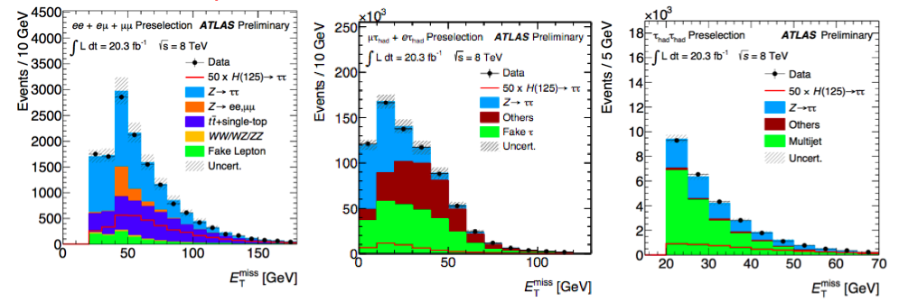
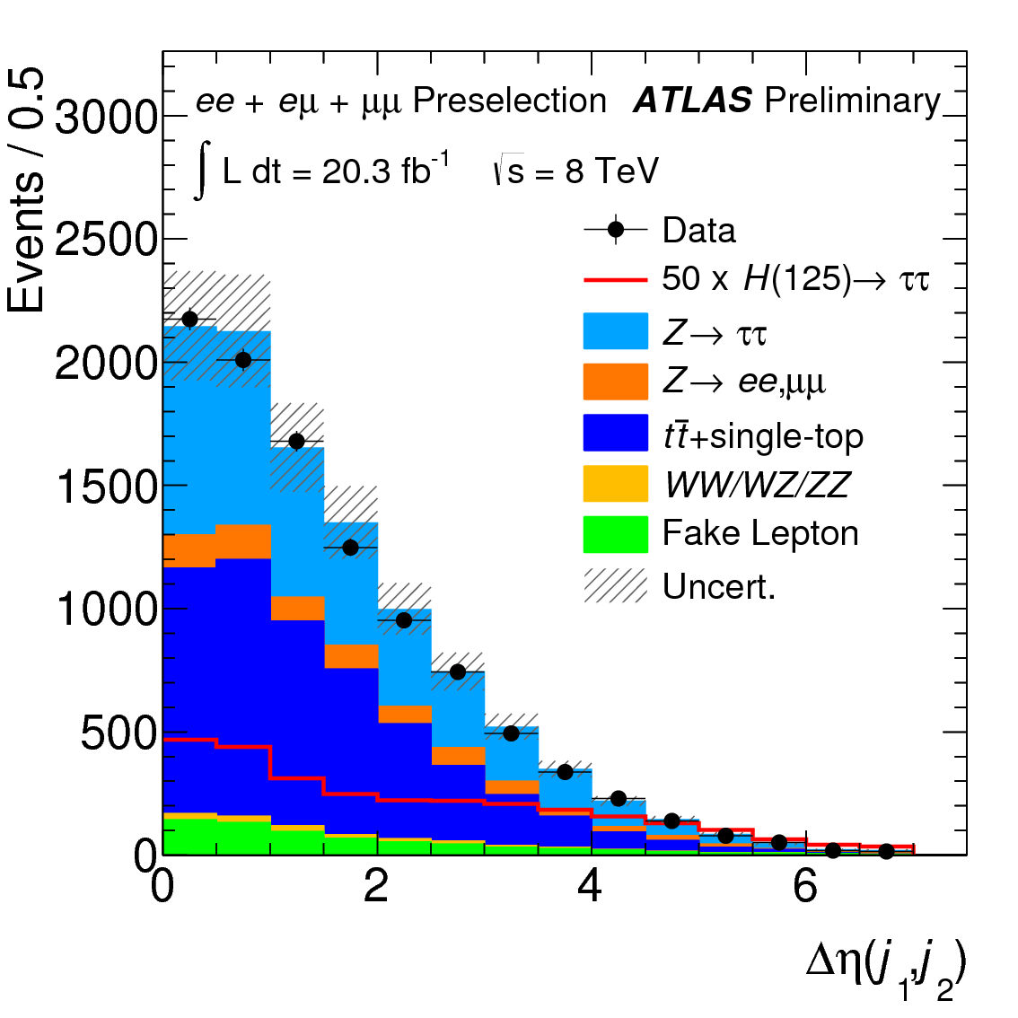
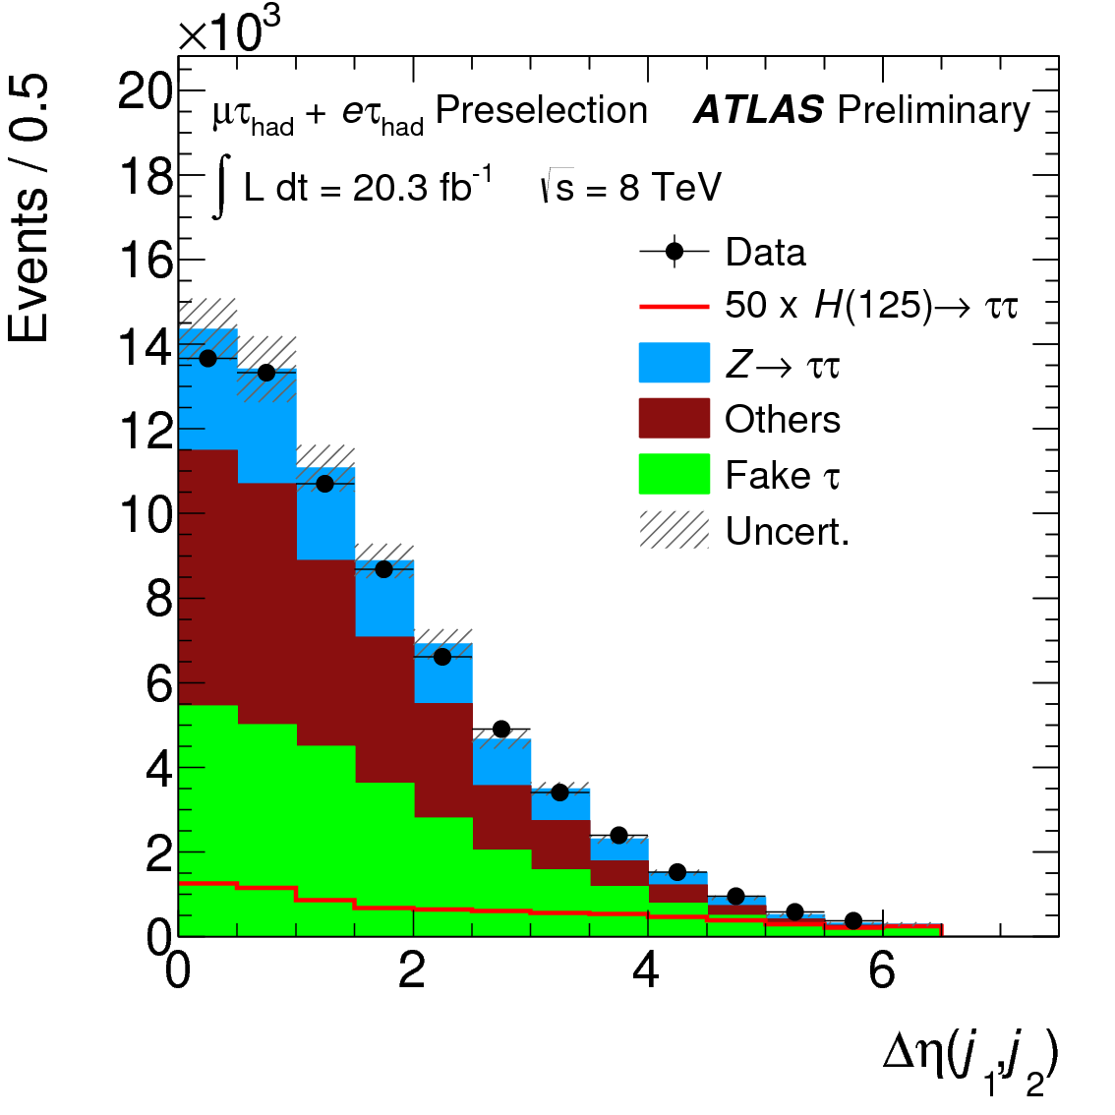
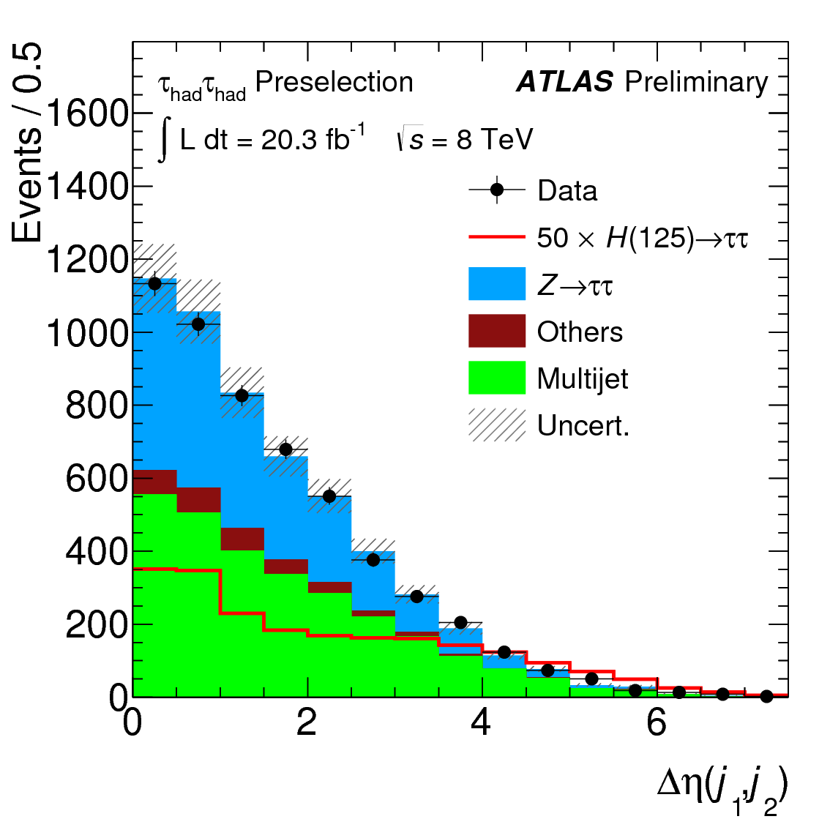
Analysis strategy
The three channels have different background compositions
Lepton Lepton
Lepton Hadron
Hadron Hadron
Major background contributions from Ztautau and “Fake taus” from multijets: Both are modeled with data.
The other backgrounds are modeled with Monte Carlo. In the case of ttbar in leplep, and W+jets in lephad, normalization is found with data.

Slide 9
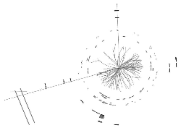
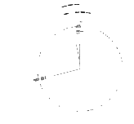
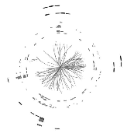
Z→ττ Simulation: Embedding
Embedding: all properties of a Z→ττevent except the taus are modeled by Z→ μμdata
Remove μ from data
Simulate τ including spin
Add τ in place of the μ
Major advantages of embedding: Z-boson kinematics, jets, MET resolution, pile-up, and VBF/EWK production are directly modeled by data
Z→μμ from data
τ from Z→ττ MC
μ1
τ1
τ2
μ2
τ1
τ2
Z→ττ with event properties from data

Slide 10
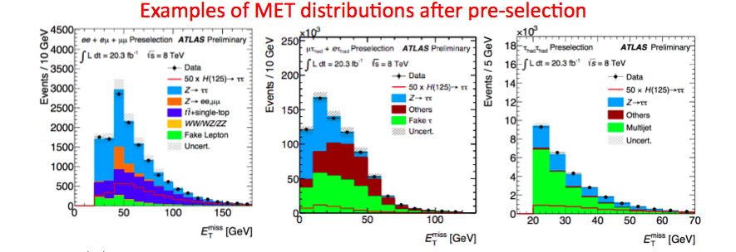
Modeling Multijet Background
QCD Multijet background is estimated directly from data
Lep-Lep: “anti-isolated” leptons
Lep-Had: sample of taus that fail ID requirements
Had-Had: events with taus that fail the Opposite Sign requirement

Slide 11
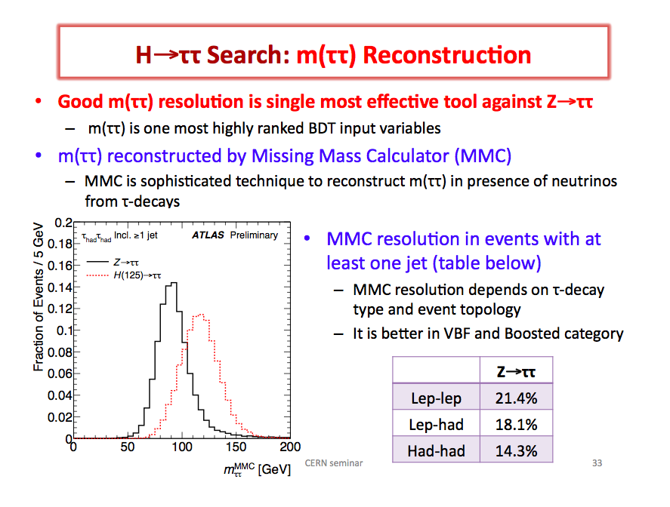
Missing Mass Calculator
Good m_{ττ} resolution provides separation between H and Z→ττ
Final state neutrinos are a problem. Ditau Mass is reconstructed with the Missing Mass Calculator (MMC)
Use the MC probability distributions for neutrino positions w.r.t. taus e.g. dR(τν)

Slide 12
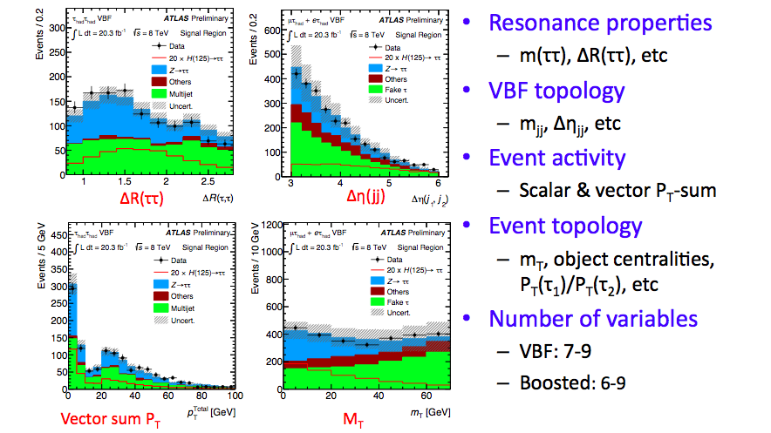
Inputs to the BDT

Slide 13
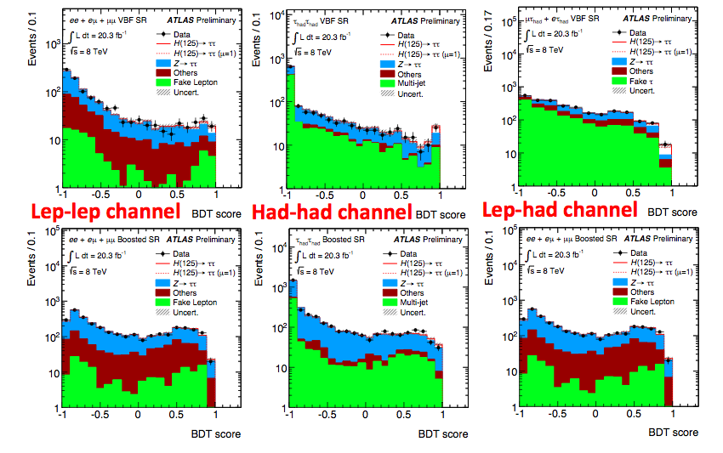
BDT Scores

Slide 14
Results
Numbers of events in highest
BDT-score bin
 | Lep-lep | Lep-had | Had-had
Signal | 5.7±1.7 | 8.7±2.5 | 8.8±2.2
Bkgd | 13.5±2.4 | 8.7±2.4 | 11.8±2.6
Data | 19 | 18 | 19
VBF
Signal | 2.6±0.8 | 8.0±2.5 | 3.6±1.1
Bkgd | 20.2±1.8 | 32±4 | 11.2±1.9
Data | 20 | 34 | 15
Boosted
The log(Signal/Bkgd) for each event’s BDT-score bin

Slide 15
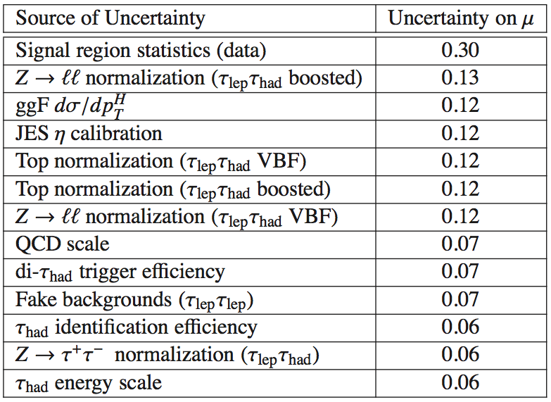
Leading Systematic Uncertainties:
Leading theory uncertainty is due to effect of top, bottom, charm quark masses in gluon-gluon loop, affecting P_{T}(H) spectrum in gluon fusion produced H (~30%)
Working with the LHC Higgs Cross Section group to come up with the best way to treat these theory systematics
Leading experimental uncertainties are due to background normalizations (up to ~20%)
Notes:
There is also some interaction with CMS and the LHC H cross section working group to come up with the best way to treat these
Leading theory uncertainty is due to effect of quark masses on PT(H) spectrum in gluon fusion production (~30%)
• Leading experimental uncertainYes are due to background normalizaYons (up to ~20%)
Some of our largest uncertainties come from theory. Maybe get a slide from Elisabetta on this. You might also reference what Bill was saying about CMS being less conservative than ATLAS in their systematics such that we end up with bigger systematics, and mention there's a theory/cms/atlas forum where this is being discussed (just a suggestion, up to you).

Slide 16
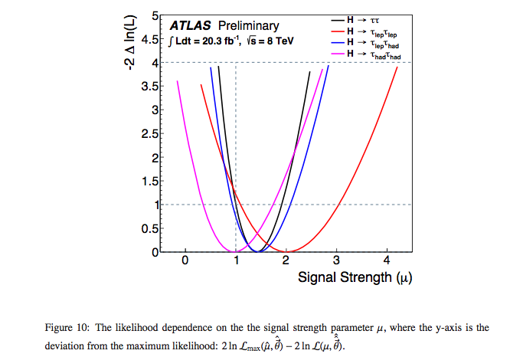
The Combined Fit
To determine the signal strength of the analysis, a pdf of each background and MC signal is made.
A simultaneous fit is done in all channels:
The backgrounds and signals are allowed to move within their systematic uncertainties
The normalizations for many backgrounds are floated
Best fit for the signal strength (μ, measured CS*BR / SM CS*BR ) is extracted.
Notes:
Fit BDT shape with signal+background templates
– Simultaneous fit in 6 SR and 5 CR with common systematics NP’s
– Z→ττ, Top, multijet (in had-­‐had) & Z→ll normalizations are free in the fit •
Control regions to constrain normalization of Top & Z→ll • Had-­‐had channel: multijet & Z→ττ constrained in Rest category

Slide 17
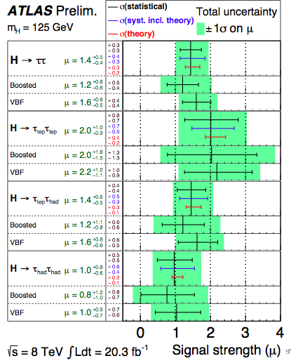
Results
ATLAS observes significant excess of data events in high S/B region
– Expected significance at M_{H}=125 GeV: 3.2 sigma
– Observed significance at MH=125 GeV: 4.1 sigma
Measured signal strength μ=1.4 (+0.5 ‐0.4)
Notes:
– Excess is observed in all three channels

Slide 18
Atlas Higgs Results

Slide 19
Compatibility With M_{H}=125 GeV
This analysis was not designed to measure the H mass. But we can look at how well the excess matches various mass hypotheses
Each event is weighted by ln(1+S/B) for corresponding bin in BDT-score
Excess of data events is consistent with presence of Higgs at 125 GeV
Signals at M_{H}=110, 125 and 150 GeV are shown at best fit μ; post-fit background normalizations

Slide 20
Summary
Using a multivariate analysis we see evidence of SM Higgs decaying to taus with a significance of 4.1 sigma where 3.2 was expected.
Measured signal strength (measured/SM) is 1.4 ^{+0.5} _{– 0.4}
Notes:
Paper expected in early spring so results can be included in the Run I ATLAS Higgs combination.

Slide 21
Backup

Slide 22
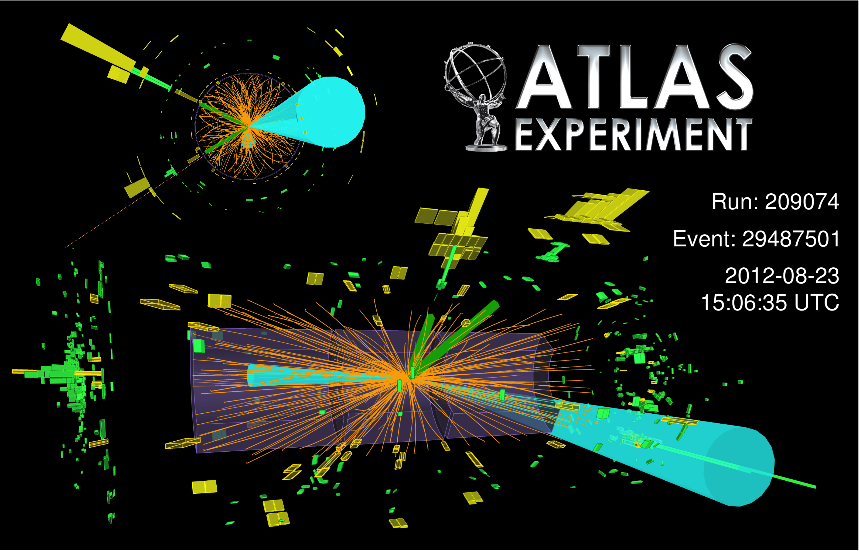
H→ττ Candidate Event In Had-Had Channel

Slide 23
Short review of H→ττ
November 2012, HCP Kyoto:
Both ATLAS and CMS had Htautau search results consistent with either signal or background.
Both ATLAS and CMS use cut based analyses.
~ fb⁻¹ of data
March 2013, Moriond.
CMS showed signal at 2.8 sigma.
26 November 2013 Cern Seminar Meeting:
ATLAS showed evidence for Htautau: 3.2 σexpected, 4.1σ observed with 20.3 fb⁻¹ of 8 TeV data
3 December 2013 CERN-LHC Seminar:
CMS showed evidence for Htautau 3.6 σ expected, 3.4 σ observed evidence. 19.7 fb-1 of 8 TeV + 4.9 of 7 TeV

Slide 24
Monte Carlo Samples
MC Sample | Generator
GGF | POWHEG w/(NLO) QCD (CT10 PDF)
VBF | POWHEG w/(NLO) QCD (CT10 PDF)
VH | LO QCD PYTHIA (CTEQ6L1)
W/Z+jets | ALPGEN. MLM matching scheme between the hard process and the parton shower (calculated with LO matrix elements for up to five jets)
ttbar | MC@NLO (CT10)
single top (t/s channel, Wt) | ACERMC (CTEQ6L1)
WZ, ZZ, & WW for leplep | HERWIG (CTEQ6L1)
WW (lephad and hadhad) | ALPGEN interfaced to HERWIG (CTEQ6L1)
Soft-gluon resummation up to NNLLog order. The finite quark-mass effects are taken into account in POWHEG. The parton shower, hadronization and underlying event simulations are provided by PYTHIA.

Slide 25
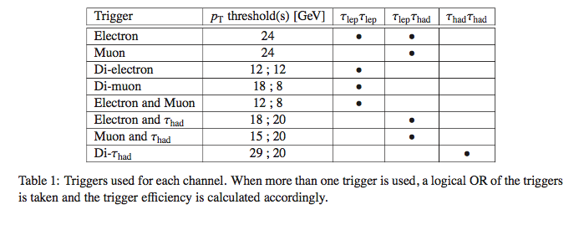
Triggers

Slide 26
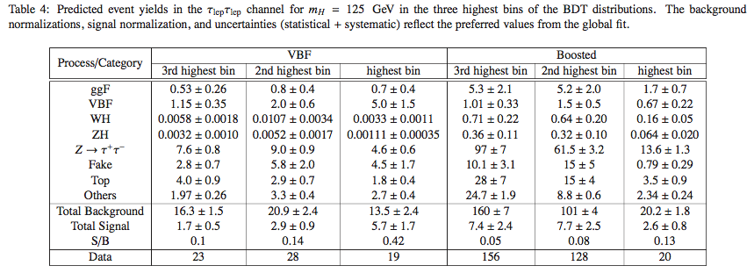
Yields for top 3 BDT bins

Slide 27
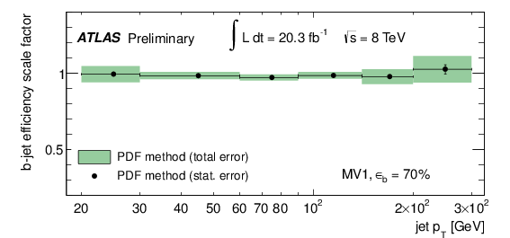
b-Tagging @ ATLAS
Data-to-MC scale factor vs P_{T}(jet)
H→ττuses a NN b-tagging algorithm with a working point corresponding to 70% b-tagging efficiency
Provides rejection factor of ~5 and ~150 against c-jets and light flavor jets
b-jet data-to-MC scale factors (SF) derived using ttbar di-lepton events
b-jet SF uncertainty in the range 2-10%
~2% in the most important P_{T}(jet) range for H→bb search
c-jet SF uncertainty in the range 8-15%

Slide 28
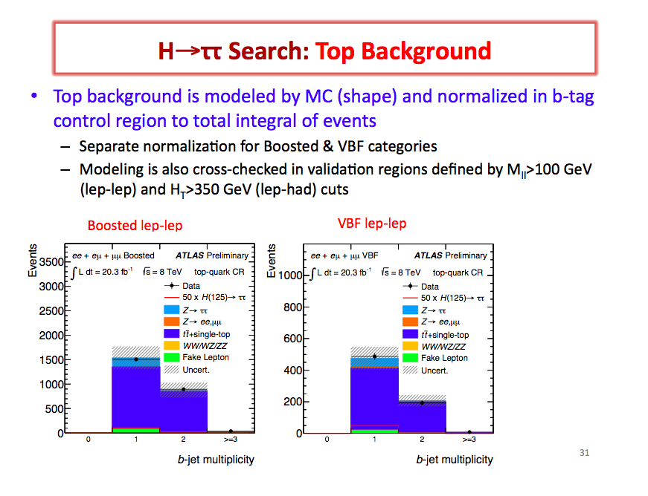

Slide 29
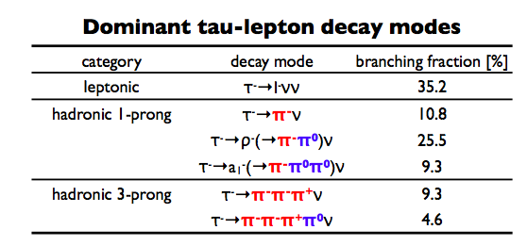

Slide 30
State of Higgs searches
As of the Nov CERN council meeting, there was convincing evidence for Higgs decays to bosons.
No evidence over 3σfor had been seen for H→Fermions had been seen but hints existed for H→bb at the Tevatron and H→tautau at CMS
 | Evidence at ATLAS | Evidence at CMS e/o
H→ γγ | 7.4σ (March ’13) | 3.5/3.9 (March ‘13)
H→ ZZ (→4leptons) | 6.6σ (March ‘13) | 6.7 σ(March ‘13)
H→WW | 3.7/3.8 (March ‘13) | 4.0σ (March ‘13)
H→bb | Limit set at 1.4xSM (July ‘13) | 2.1/2.1σ (Oct ‘13)
H→bb tevatron: 2.8σ
***NEW*** | Evidence at ATLAS | Evidence at CMS e/o
H→ττ | 4.1σ (Nov ‘13) | 3.6/3.4σ (Dec ‘13)

Slide 31
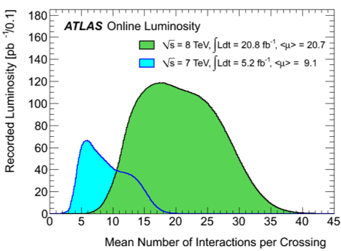

Slide 32
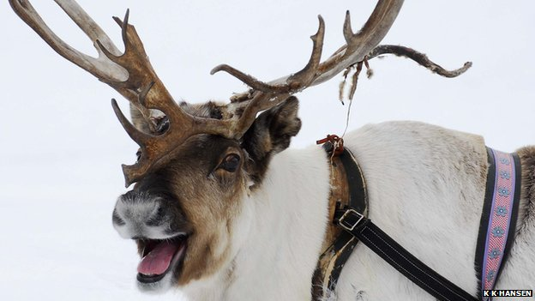
ATLAS H→ττ results
ATLAS UK
University of Edinburgh
8 January 2014
Katy Grimm* for the Htautau team
including
Eva Bouhova-Thacker*, Harald Fox*, Harvey Maddocks*
Sinead Farrington, Elisabetta Pianori, Carl Jeske
*

Slide 33
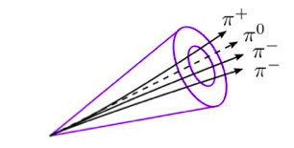
Taus at ATLAS
m_{τ} = 1.78 GeV; Decay length = 87μm – taus almost always decay within the beam pipe.
Decay Hadronically or Leptonically
Hadronic decays are highly collimated and have low track multiplicity– 1 or 3 charged pions
TauID (and lepton suppression) uses Multivariate Techniques that take advantages of shower-shape and track information
Notes:
Taus are seeded by anit-kt jets (R=4)
This provides the initial axis, the clusters, the tracks for vertex association
Tracks within dR <0.4 of jet seed are associated to the tau
The core tracks are defined as those with dR<0.2. The core tracks are used to define the charge.

Slide 34
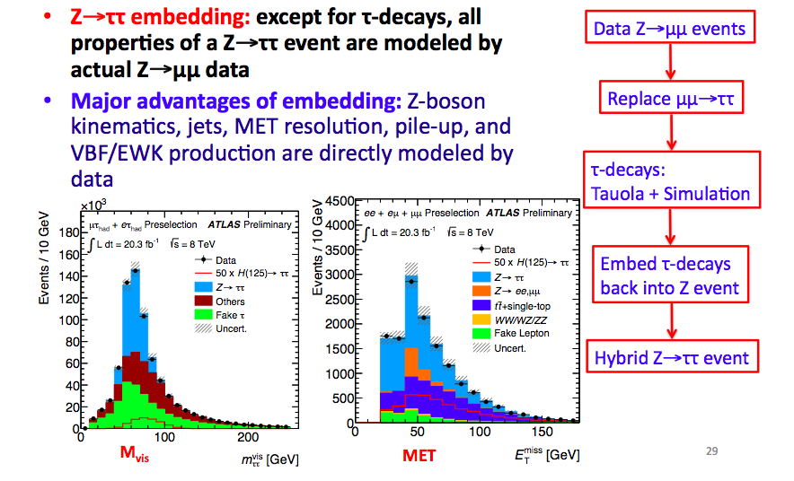
Z tautau Background
In each channel Ztautau is a major background This is modeled in Data.

Slide 35
Monte Carlo Samples
GGF & VBF: POWHEG event generator w/(NLO) QCD calculations. Soft-gluon resummation up to next-to-next-to-leading logarithm order is adopted. The finite quark-mass effects are taken into account in POWHEG. The parton shower, hadronization and underlying event simulations are provided by PYTHIA. CT10 (PDF)
VH samples are generated at leading order (LO) QCD using PYTHIA with the CTEQ6L1 PDF set.
The signal samples are normalized to cross sections computed at next-to-next-to-leading order (NNLO) QCD calculation and taken from Ref. [9].
Background samples:
Parton shower and hadronization: HERWIG [30] (with one exception noted below)
Underlying event: JIMMY.
W/Z+jets generated with ALPGEN. MLM matching scheme between the hard process and the parton shower (calculated with LO matrix elements for up to five jets). The τlepτhad channel uses these samples interfaced with PYTHIA rather than HERWIG.
ttbar : MC@NLO [34] with NLO accuracy.
Single-top (t/s channel, Wt) : ACERMC [35].
The diboson (WW, WZ, ZZ) MC samples are generated using HERWIG for the τlepτlep channel. In the τhad τhad and τlep τhad channels, HERWIG is used for the W Z and Z Z samples, while the W W sample is obtained using ALPGEN interfaced to HERWIG. The loop-induced gg → WW processes are generated using gg2WW [36]. The PDF set used with the ACERMC, ALPGEN and HERWIG event generators is CTEQ6L1, while CT10 is used for the generation of events with MC@NLO and gg2WW. TAUOLA [37] and PHOTOS [38] perform the τ decay and additional photon radiation from charged leptons, respectively, for all samples described. The normalization for these backgrounds is either estimated from data control regions, as described in Section 9, or NLO cross sections are used.

Slide 36
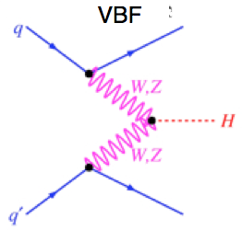
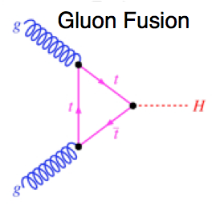
H→ττ Analysis Strategy
Htautau is primarily sensitive to the VectorBosonFusion and Gluon-fusion production modes. To take advantage of the two production signatures, we divide events into two categories: More-VBF-like, More-GFF-like, for each tau-decay channel.
Train events separately for the two categories and three tau channels.
2 forward jets
Much Cleaner Signature
Much Higher Rate

Slide 38
Yields in the Highest BDT Bins
Predicted Signal and Background yields and final Data yields for the highest BDT bin in each channel and category:
 | Lepton Lepton | Lepton Hadron | Hadron Hadron
 | Sig/Bkgd/Data | S/B/D | S/B/D
VBF Category | 5.7±1.7/ 13.5±2.4/ 19 | 8.7±2.4/ 8.7±2.5/ 18 | 8.0±2.2/ 11.8±2.6/ 19
Boosted Category | 2.6±0.8/ 20.2±1.8/ 20 | 8.0±2.5 / 32±4/ 34 | 3.6±1.1/ 11.2±1.9/ 15

Slide 39
Signal Region Categories
Sub Categories with in each channel are created based on signal kinematics
Forward jet signature
Largest production mode
Events in each channel are split into a “VBF” and “Boosted” categories. The VBF category requires 2 separated forward jets. The Boosted category requires pT_{Higgs} > 100 GeV. Separate BDTs are trained for the two categories.

